Slide 1
Electrolyte -I
Elham Omar
Sohag University

Slide 2
Electrolytes.
They are substances whose molecules dissociate into ions when placed in solution.
They are classified as anions or cations based on the type of charge they carry.
Anions
Have a negative charge and move toward the anode (Cl⁻ & HCO₃⁻).
Cations
Have positive charge migrate to the cathode (Na⁺, k⁺, Ca⁺⁺ & Mg⁺⁺).

Slide 3
Calcium Distribution
99% in skeleton (bone)
1% is mostly in the blood and other ECF. About 50% circulates as free Ca ²⁺ ions (referred to as ionized Ca), 40% is bound to protein, mostly albumin, and 10% is complexed to anions, such as HCO3, citrate,PO4, and lactate.

Slide 4
Ca²⁺ Function
Bone mineralization:
Ca is an essential element in bone and teeth.
Ionized Ca:
Blood coagulation and milk clotting.
Membrane permeability.
Muscle and Nerve excitability:
Second messenger of many hormones
6. For activity of lipase, phosphorylase and α- amylase enzyme

Slide 5
Control of blood calcium & phosphorus
The control is regulated by action of 3 hormones:
1- PTH
2- Vitamin D
3- Calcitonin
Through their actions on:
1- Intestine
2-kidney
3-Bone.
.

Slide 6
Parathyroid Hormone
PTH is synthesized and secreted by the parathyroid gland which lie posterior to the thyroid glands.
The Chief Cells in the parathyroid gland are the principal site of PTH synthesis.
PTH secretion in blood is stimulated by a decrease in ionized Ca⁺⁺ and, conversely, PTH secretion is stopped by an increase in ionized Ca⁺⁺ .

Slide 7
Parathyroid Hormone Action
The overall action of PTH is to increase plasma Ca⁺⁺ levels and decrease plasma phosphate levels through:
1-kidney:
a-Activates renal 1α-hydroxylase (stimulate 1,25-(OH)₂-D synthesis).
B-Increases renal tubular reabsorption of Ca⁺⁺ and decrease renal tubular reabsorption of phosphate thereby increases phosphate excretion
2-Small intestine:
PTH also acts indirectly on intestine by stimulating 1,25-(OH)₂-D synthesis, which increase intestinal absorption of both.
3- Bone:
PTH activates a process known as bone resorption, in which activated osteoclasts break down bone and subsequently release Ca⁺⁺ fom bone into the ECF.

Slide 8
Synthesis of Vitamin D
Humans acquire vitamin D from two sources.
Vitamin D is produced in the skin by ultraviolet radiation and ingested in the diet.
Vitamin D is not a classic hormone because it is not produce and secreted by an endocrine “gland.” Nor is it a true “vitamin” since it can be synthesized de novo.
Vitamin D is a true hormone that acts on distant target cells to evoke responses after binding to high affinity receptors

Slide 9
Synthesis of Vitamin D
Vitamin D3 synthesis occurs in keratinocytes in the skin.
7-dehydrocholesterol is photoconverted to previtamin D3, then spontaneously converts to vitamin D3( cholecalciferol).
Vitamin D2 (ergocalciferol) produced from ergosterol from the diet.

Slide 10
Vitamin D transport
Vitamin D is a lipid soluble hormone that binds to a typical nuclear receptor, analogous to steroid hormones.
Because it is lipid soluble, it travels in the blood bound to globulin (vitamin D binding protein).

Slide 11
Synthesis of Vitamin D
Vitamin D3 or vitamin D2 itself is inactive, it requires modification to the active metabolite, 1,25-dihydroxy-D.
The first hydroxylation reaction takes place in the liver yielding 25-hydroxy D by 25- hydroxylase enzyme, still an inactive form of vitamin D.
Then 25-hydroxy D is transported to the kidney where the second hydroxylation reaction takes place by 1α-hydroxylase enzyme.

Slide 12
The 1α-hydroxylase enzyme is the point of regulation of D synthesis.
Feedback regulation by 1,25-dihydroxy D inhibits this enzyme.
PTH stimulates 1α-hydroxylase and increases 1,25-dihydroxy D.

Slide 13
Vitamin D Action
- The active form of vitamin D (1,25 dihydroxy cholecaciferol)
- produced in kidney in response to low calcium & phosphate level.
1- Small intestine:
Increases calcium & phosphate absorption.
2-kidney:
Promotes Renal tubular reabsorption of Ca and HPO.
3- Bone:
Enhances the effect of PTH on bone resorption.

Slide 14
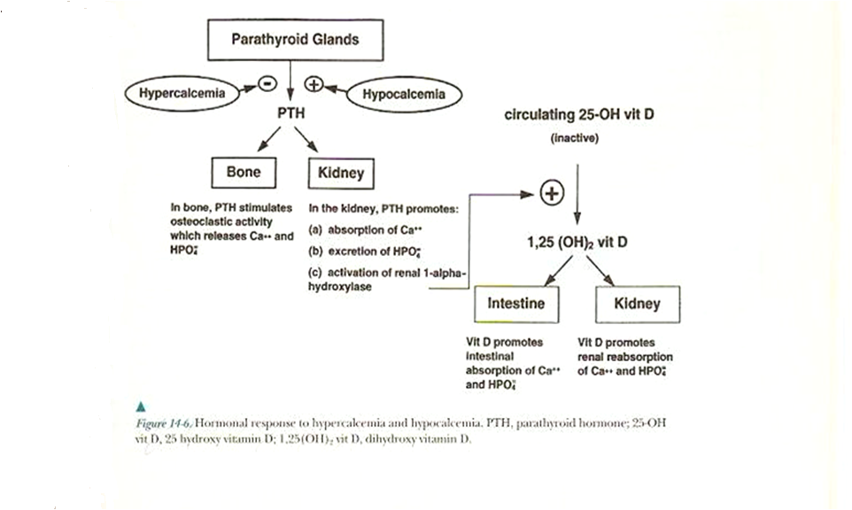
Regulation of Ca metabolism

Slide 15
Calcitonin
Calcitonin is synthesized and secreted by the parafollicular cells of the thyroid gland. Calcitonin acts to decrease plasma Ca⁺⁺ levels.
While PTH and vitamin D act to increase plasma Ca⁺⁺ only calcitonin causes a decrease in plasma Ca⁺⁺.
The major stimulus of calcitonin secretion is a rise in plasma Ca⁺⁺ levels
Calcitonin is a physiological antagonist to PTH with regard to Ca⁺⁺ homeostasis
Calcitonin exerts its Ca-lowering effect by inhibiting the actions of both PTH and vitamin D. Although calcitonin is apparently not secreted during normal regulation of the ionized Ca concentration in blood, it is secreted in response to a hypercalcemic stimulus.

Slide 16
Calcitonin Action
Lowers both plasma calcium and phosphorus by:
1-Bone:
Inhibits osteoclasts, stimulates osteoblasts so
inhibiting calcium mobilization from bone.
2- kidney:
Decreasing renal tubular reabsorption of calcium & phosphorus ( increases Ca and Ph excretion).

Slide 17
Disorders of blood calcium level
Hypercalcemia:
Primary hyperparathyroidism, adenoma or glandular
hyperplasia
Malignancy
Endocrinopathy Thyrotoxicosis, .
Drug induced: increased vitamin D (↑ intestinal absorption), Thiazide diuretics(↑ renal retention)
Prolonged immobilization

Slide 18
Hypercalcemia of Malignancy
Underlying cause is generally excessive bone resorption by one of three mechanisms
1,25-(OH)2-D synthesis by lymphomas
Local osteolytic hypercalcemia
20% of all hypercalcemia of malignancy e.g MM
Humoral hypercalcemia of malignancy
Over-expression of PTH-related protein (PTHrP)

Slide 19
PTHrP
Three forms of PTHrP identified, all about twice the size of native PTH
Marked structural homology with PTH
PTHrP and PTH bind to the same receptor
PTHrP reproduce full spectrum of PTH activities

Slide 20
Symptoms of hypercalcemia
A mild hypercalcemia [10.5–12 mg/dL]) is often asymptomatic.
Moderate or severe Ca elevations include neurologic, GI, and renal symptoms (↓neuromuscular exitability).
Neurologic symptoms:
mild drowsiness or weakness, depression, lethargy, and coma.
GI symptoms:
constipation, nausea, vomiting, anorexia, and peptic ulcer disease.
Renal symptoms:
nephrolithiasis and nephrocalcinosis. Hypercalciuria can result in nephrogenic diabetes insipidus, which causes polyuria, thrist that results in hypovolemia, which further aggravates the hypercalcemia.
Heart symptoms:
ECG changes and cardiac arrest
.

Slide 21
Hypocalcemia:
Hypoalbuminemia
(total calcium only, ionized not affected by)—chronic liver disease, nephrotic syndrome, malnutrition. For each 1 g/dL decrease in serum albumin below 4g/dl, there is a 0.2 mmol/L (0.8 mg/dL) decrease in total Ca levels
Chronic renal disease
Hypomagnesemia
Hypoparathyroidism
Pseudohypoparathyroidism
Vitamin D deficiency

Slide 22
Hypocalcemia:
A level <7 Mg/dl is a panic level
< 7.5 mg/dl→ [↑ neuromuscular irritability] parasethesia, muscle cramps & tetany → Laryngeal spasm.
Cardiac symptoms may include arrhythmia or heart block.
Chronic ↓→ bone deformity especially in weight bearing bone (Rickets and osteomalacia).

Slide 23
Reference Ranges
Reference ranges for calcium
Total calcium (serum, plasma)
Child 2.20-2.70 mmol/L (8.8-1 0.8 mg/dL)
Adult 2.15-2.50 mmol/L (8.6-1 0.2 mg/dL)
Ionized calcium (serum)
Neonate 1.20-1.48 mmol/L (4.8-5.9 mg/dL)
Child 1.20-1.38 mmol/L (4.8-5.5 mg/dL)
Adult 1.15-1.30 mmol/L (4.6-5.3 mg/dL)
Urine (24-hour) 2.50-7.50 mmol/day (100-300 mg/day), varies with diet

Slide 24
Determination of Calcium
Specimen
The preferred specimen for total Ca determinations is either serum or lithium heparin. Anticoagulants such as EDTA or oxalate bind Ca tightly and interfere with measurement,
For analysis of Ca in urine, an accurately timed urine collection is preferred. The urine should be acidified with 6 mol/L HCl, with approximately 1 mL of the acid added for each 100 mL of urine.

Slide 25
Methods:
The two commonly used methods for total Ca analysis
- Photometric Methods either cresolphthalein complexone (CPC) or arsenzo III dye to form Ca dye complex.
- Atomic Absorption spectrophotometric methods
Corrected [Ca] =
measured [Ca] + 0.8x( 4 – [albumin] )
For Free Ca:
Calcium ion-selective electrodes

